Slide 1

SDP MID-TERM EVALUATION
Early Prediction of Cardiovascular Diseases using Electronic Health Record (EHR) using
Deep Learning and Machine Learning Techniques.
Supervised By: Dr. Dibya Ranjan Das Adhikary
Group No: 16
Name of the Student(s) with Regd. No.:
Sai Swarupa Das 2041004023
Ayushman Rath 2041018071
Ashutosh Ranjan 2041018054
Nishikant 2041014087
Department of Computer Sc. and Engineering
Faculty of Engineering & Technology (ITER)
Siksha ‘O’ Anusandhan (Deemed to be) University
Bhubaneswar, Odisha
‹#›

Slide 2
Presentation Outline
Introduction
Motivations
Uniqueness of the work
Literature Survey
Existing System
Problem Identification
Schematic Layout OR Model Diagram
Methods OR Tools OR Algorithms used
Experimentation and Results
System Specifications
Datasets Description
Parameters used (if any)
Experimental outcomes (Tables and Figures)
Summary (Key findings)
Bibliography
‹#›

Slide 3
Introduction
Overview
Cardiovascular Disease (CVD) is a major cause of death worldwide, killing about 17.9 million people each year, according to the World Health Organization. This makes up nearly 31% of all deaths globally. Factors like lack of exercise, poor diets, obesity, diabetes, high blood pressure, smoking, and heavy drinking contribute to heart disease, even affecting younger people.
The research paper "Early Prediction of Cardiovascular Diseases using Electronic Health Record (EHR) using Deep Learning and Machine Learning Techniques" looks at how machine learning can help predict heart disease early. The study uses different method Logistic Regression, Decision Tree Classifier, Random Forest Classifier, K Neighbours Classifier, Gradient Boosting Classifier to sort patients based on their symptoms and medical data, which helps doctors treat them sooner and more effectively.
‹#›

Slide 4
Introduction contd..
Motivations
Global Health Impact
Potential of Machine Learning
Early Detection
Healthcare Improvement

Slide 5
Literature Survey
Existing System
Sr. No 1. | Paper Title Prediction of Cardiovascular Disease Using Machine Learning Technique — A Modern Approach | Authors Visvasam Devadoss Ambeth Kumar, Chetan Swarup, Indhumathi Murugan, Abhishek Kumar, Kamred Udham Singh, Teekam Singh Ramu Dubey | Research Findings Developed a model using Support Vector Machine (SVM) with high accuracy (85%) in early-stage CVD prediction. | Problems in Algorithm Small dataset size, risk of overfitting, and limited generalizability to larger populations.
‹#›

Slide 6
Literature Survey
Existing System
Sr. No 2. | Paper Title Heart disease prediction using supervised machine learning algorithms: Performance analysis and comparison | Authors Md Mamun Ali, Bikash Kumar Paul, Kawsar Ahmed, Francis M. Bui | Research Findings Proposed a prediction model based on prescription data mining method Introduced a heart disease prediction model using hybrid machine learning techniques | Problems in Algorithm Comparative low performance (73.17% accuracy) compared to other classification algorithms and methods Identified the need for better accuracy compared to other classification algorithms
‹#›

Slide 7
Literature Survey
Existing System
Sr. No 3. | Paper Title Heart disease risk prediction using deep learning techniques with feature augmentation. | Authors Maria Teresa Garcia-Ordas, Martin Bayon-Gutierrez, Carmen Benavides, Jose Aveleira-Mata, Jose Alberto Benitez-Andrades | Research Findings Deep learning methods combined with feature augmentation significantly improve the prediction of cardiovascular disease risk, achieving a precision of 90%. | Problems in Algorithm The algorithm may face challenges in handling large datasets efficiently and may require substantial computational resources.
‹#›

Slide 8
Literature Survey
Existing System
Sr. No 4. | Paper Title Prediction of Heart Disease Using a Combination of Machine Learning and Deep Learning | Authors Aditya Khamparia, Gaurav Dhiman, Mohammad Shabaz, Parneet Singh, Rohit Bharti, Sagar Pande | Research Findings Combination of AdaBoost classifier with PCA led to increased prediction accuracy. Machine learning algorithms performed better in the analysis of heart disease prediction. | Problems in Algorithm Difficulty in interpreting the results of complex ensemble models like Random Forest. Overfitting of the models due to high dimensionality of the dataset.
‹#›

Slide 9
Literature Survey
Existing System
Sr. No 5. | Paper Title Effective Heart Disease Prediction Using Machine Learning Techniques | Authors Chintan M. Bhatt, Parth Patel, Tarang Ghetia and Pier Luigi Mazzeo | Research Findings The study demonstrates the potential to improve the performance of predictive models for cardiovascular disease using machine learning algorithms. | Problems in Algorithm Some common problems in algorithms include overfitting, underfitting, data leakage, and bias in the training data.
‹#›

Slide 10
Literature Survey
Existing System
Sr. No 6. | Paper Title Effective Heart Disease Prediction Using Hybrid Machine Learning Techniques | Authors SENTHILKUMAR MOHAN, CHANDRASEGAR THIRUMALAI, AND GAUTAM SRIVASTAVA | Research Findings The performance of the classifier is optimized by choosing the Decision Tree cluster with a high rate of error and extracting its corresponding classifier features. The performance is evaluated for error optimization on this dataset. | Problems in Algorithm One problem in the Decision Trees algorithm is that tree pruning is necessary to remove irrelevant samples, which can be a challenging task.
‹#›

Slide 11
Literature Survey
Existing System
These are some of the following problems in existing system:
Late Diagnosis: Traditional methods often identify CVD at advanced stages, limiting treatment effectiveness.
High False Positives/Negatives: Conventional tools can be inaccurate, causing unnecessary treatments or missed diagnoses.
Limited Data Utilization: Many methods fail to fully exploit available medical data, missing important patterns for early detection.
Complexity of CVD: The multifactorial nature of CVD makes accurate prediction challenging with traditional techniques.
Resource Intensive: Current methods are time-consuming and require significant expertise, which may not be available everywhere.
Scalability Issues: Traditional diagnostic approaches struggle to scale for large populations, hindering widespread screening efforts.
‹#›

Slide 12
Literature Survey Contd..
Problem Identification
Small Dataset Size
High False Positive/Negative Rates
Sensitivity to Data Quality

Slide 13
Algorithms used
The Algorithms used in the process are:
Logistic Regression
Support Vector Machine
Random Forest
K-Nearest Neighbours
Decision Tree
Gradient Boosting Classifier
‹#›

Slide 14
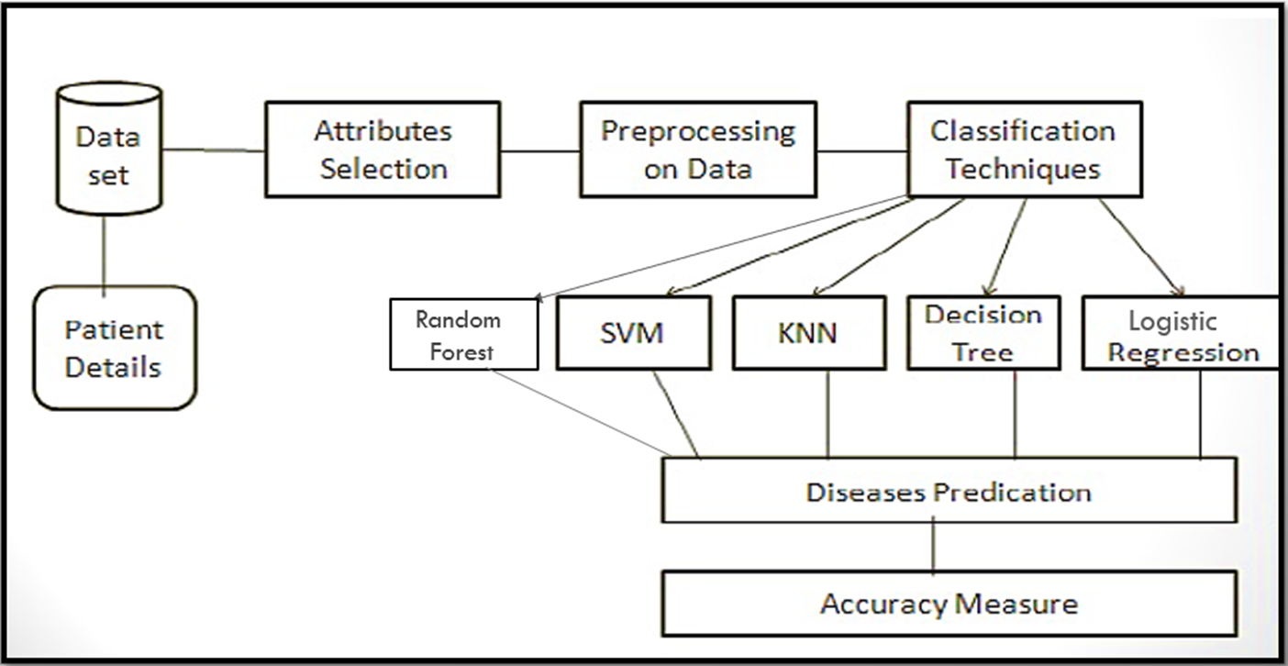
Model Diagram
‹#›

Slide 15
Experimentation and Results
System Specifications
Hardware Requirements:
Processor: Intel Core i3 or equivalent
RAM: 4 GB or higher
Storage: 128GB SSD
Software Requirements:
Operating System: Windows 10 or Ubuntu 18.04
Programming Language: Python 3.7
Libraries and Frameworks:
Scikit-learn: For machine learning algorithms (including SVM)
NumPy: For numerical operations
Pandas: For data manipulation and analysis
Matplotlib/Seaborn: For data visualization
Jupyter Notebook: For developing and testing the model

Slide 16
Experimentation and Results Contd..
Datasets Description
Heart Disease Dataset dates from 1988. It contains 76 attributes, including the predicted attribute, but all published experiments refer to using a subset of 14 of them. The "target" field refers to the presence of heart disease in the patient. It is integer valued 0 = no disease and 1 = disease. The dataset consists of 500 rows and 14 columns, and the data types for all features are int64/float64.
The names of the features in the data set are abbreviated and the meaning of these features is difficult to understand. The full medical/technical names are hard to understand for most of us let alone their abbreviated form. To better understand the meaning of the features, we have the responsibility to explain some of the attributes of dataset as follows: • age: age in years • sex: sex (1 = male; 0 = female) • cp: chest pain type ( 0 = typical angina; 1 = atypical angina; 2 = non-anginal pain; 3 = asymptomatic) • trestbps; resting blood pressure (in mm Hg on admission to the hospital) • chol: serum cholestoral in mg/dl • fbs: (fasting blood sugar > 120 mg/dl) (1 = true; 0 = false) • restecg: resting electrocardiographic results (0 = normal; 1 = having ST-T wave abnormality (T wave inversions and/or ST elevation or depression of > 0.05 mV); 2 = showing probable or definite left ventricular hypertrophy by Estes' criteria) • thalach: maximum heart rate achieved • exang; exercise induced angina (1 = yes; 0 = no) • oldpeak: ST depression induced by exercise relative to rest • slope: the slope of the peak exercise ST segment (0 = upsloping; 1 = flat; 2 = downsloping) • ca: number of major vessels (0-3) colored by flourosopy • thal: (0 = error (in the original dataset 0 maps to NaN's); 1 = fixed defect; 2 = normal; 3 = reversable defect) • target (the lable): (0 = no disease; 1 = disease)

Slide 17
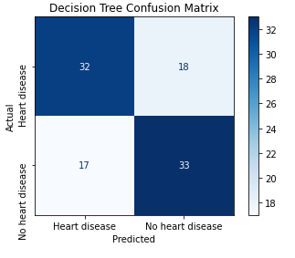
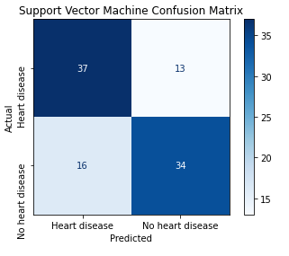
Experimentation and Results Contd..

Slide 18
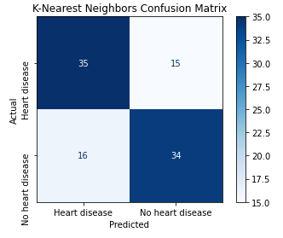
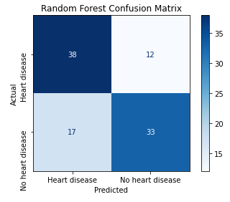
Experimentation and Results Contd..

Slide 19
Summary(Key Findings)
Hybrid Method Development and Evaluation
High Accuracy with SVM
Combining Machine Learning and Deep Learning Techniques
Deep Learning with Feature Augmentation
Challenges in Existing Models
‹#›

Slide 20
Bibliography
Effective Heart Disease Prediction Using Hybrid Machine Learning Techniques
Heart disease prediction using supervised machine learning algorithms: Performance analysis and comparison
Heart disease risk prediction using deep learning techniques with feature augmentation
Effective Heart Disease Prediction Using Machine Learning Techniques
Prediction of Cardiovascular Disease Using Machine Learning Technique—A Modern Approach
Prediction of Heart Disease Using a Combination of Machine Learning and Deep Learning

Slide 21

‹#›

